Slide 1


Foundational Project - 1
STOCK MARKET SENTIMENT ANALYSIS MODEL

Slide 2
Meet the Team GROUP 4
Deepti Gupta – 12220041
Prathyusha Thatipelli – 12220044
Paritosh Sinha – 12220056
Mridul Markandya – 12220069
Aparna Ravishankar – 12220087

Slide 3












Index
Overview
Architecture
Understanding – Business and Data
Data – Collection and Preparation, and Quality Verification
Modelling
Evaluation
Model Deployment
Monitoring and Maintenance
Working of the Model
Challenges and Limitations
Future Scope
References

Slide 4
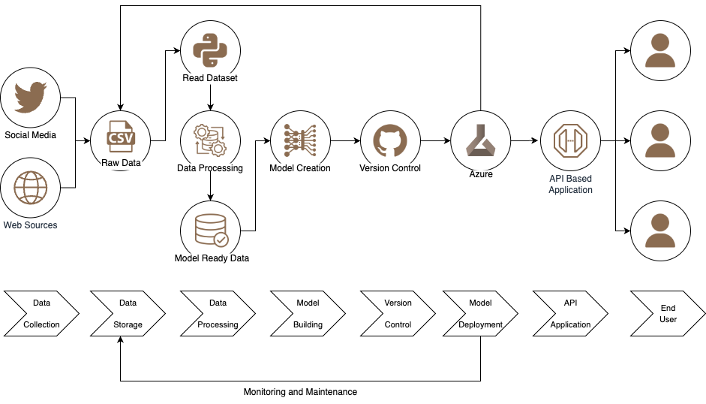
Architecture Planned

Slide 5
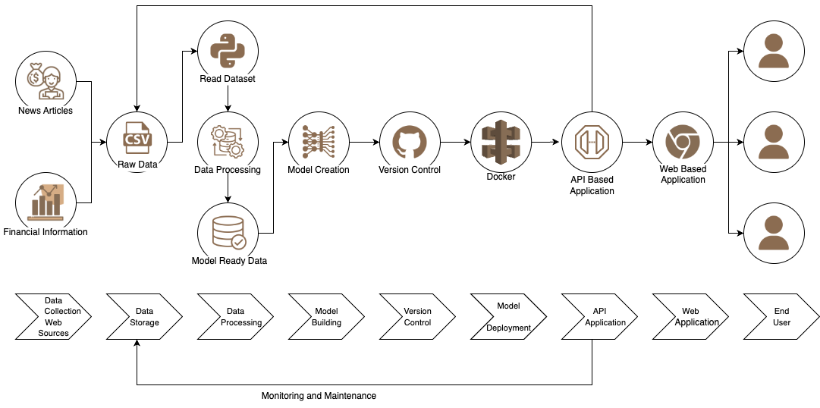
Architecture Followed

Slide 6
Overview – CRISP MLQ Methodology
Understanding – Business and Data
Monitoring and Maintenance
Data – Collection and Preparation, and Quality Verification
Model Deployment
Modelling
Evaluation

Slide 7
Understanding – Business and Data
PROBLEM STATEMENT
BUSINESS OBJECTIVE
Stock prices fluctuate rapidly multiple times within a second. Investing in stocks using a hunch may throw us into losses, but taking an informed decision will always yield good results. There are a lot of stock value prediction models out in the market, but alas! all those models have poor accuracy.
Minimize Risks, Minimize Losses and Maximize Profits
Investment decision-making: The primary objective is to assist investors in making informed investment decisions by predicting market highs and lows based on sentimental analysis.
Risk management: Objective is to help users to manage risks associated with investments by providing accurate predictions of market highs and lows, which could help them make informed decisions.
Customer sentiment analysis: Possible objective could be to gain insights into customer sentiment by analysing their reactions to different external events. This information could then be used to improve customer satisfaction and loyalty.

Slide 8
Understanding – Business and Data……… continued
FEASIBILITY
SUCCESS CRITERIA
Data Availability: Data source, quality, size, format and collection issues must be considered for successful machine learning model.
Technical Feasibility: Evaluate the model technical feasibility, requirements, challenges and tools needed for machine learning model implementation.
Business Impact: Evaluate the model potential ROI, risks, benefits, challenges, and opportunities for business impact assessment.
Legal Constraints: None.
Investment Decision-making: Accuracy of the predictions of market highs and lows.
Risk management: Ability of the machine learning model to accurately predict market highs and lows for the User.
Customer sentiment analysis: Ability of the machine learning model to accurately analyse customer sentiment and provide insights that can be used to improve customer satisfaction and loyalty.
IF THE ABOVE CRITERIA MATCHES, THE MODEL IS SAID TO BE A SUCCESSFUL!!!
MACHINE LEARNING APPLICATION SCOPE
Build a stock market sentiment analysis model using news from online portal, social media platforms and other web sources.
Notes:
Success Criteria->
Investment decision-making: The success of the project could be measured by the accuracy of the predictions of market highs and lows. If the predictions are consistently accurate and help investors make profitable decisions, the project can be considered successful.
Risk management: The success of the project could be measured by the ability of the machine learning model to accurately predict market highs and lows and help financial institutions manage risks associated with investments. If the model helps reduce the frequency and severity of losses, the project can be considered successful.
Customer sentiment analysis: The success of the project could be measured by the ability of the machine learning model to accurately analyze customer sentiment and provide insights that can be used to improve customer satisfaction and loyalty. If the model helps businesses better understand their customers' needs and preferences, the project can be considered successful.
Feasibility-> Data Availability: The availability of data is crucial for the success of any machine learning project. You should mention the sources of data that will be used for the project, including the size and quality of the data, the format of the data, and any potential issues with data collection.
Technical Feasibility: You should assess the technical feasibility of the project, including the tools and technologies that will be required to implement the machine learning model. This includes hardware and software requirements, as well as any technical challenges that may need to be overcome.
Business Impact: You should assess the potential impact of the project on the business, including the expected return on investment, the potential risks and benefits, and any potential challenges or opportunities that may arise during or after the project.

Slide 9
Data – Collection and Preparation, and Quality Verification
Data Collection and Preparation
Data Quality Verification
Select Key Performance Indicators (KPIs): Relevant Variables to be decided
Select Data: Historical data of selected KPIs and news articles with relevant keywords.
Clean Data: No noise reduction necessary, missing values can be filled using EDA.
Construct Data: Derive the Sentiment (Target Variable).
Standardize Data: CSV files and perform normalization if needed.
Selected KPIs: Performance, Valuation, Growth, Profitability, Total Revenue, Profit Before Tax (PBT), Earnings Before Interest, Taxes, and Amortization (EBITDA), and Price to Earnings (PE) Ratio.
Data Requirements: Quantitative and Qualitative data, including Currency and Ratio.
Data Scrapping: Latest news to be analyzed and text analysis to be performed.

Slide 10
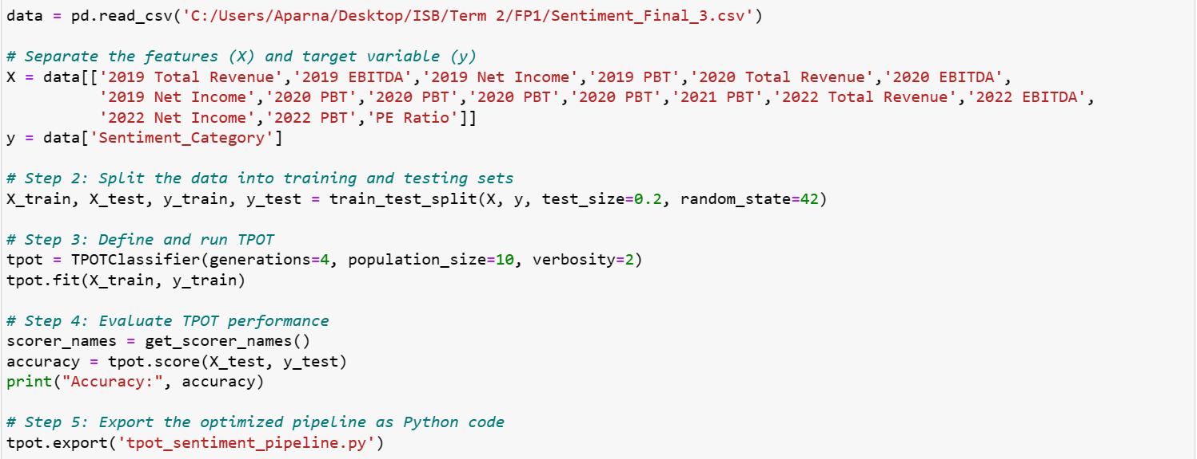
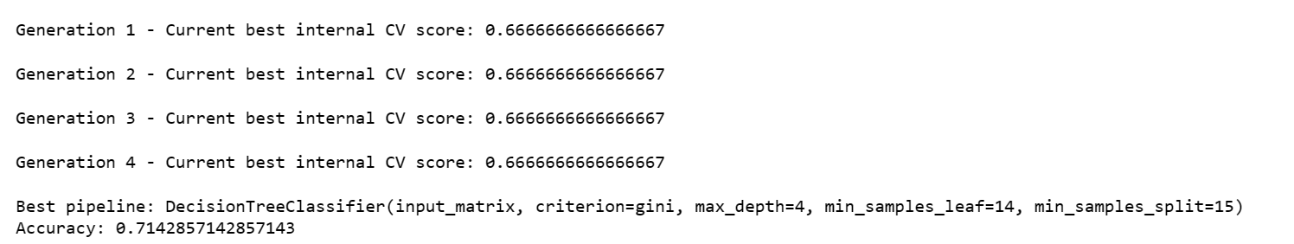
Modelling – Prototype
Software Used: Azure Machine Learning Studio
Coding Approach: No Code
Method: Auto ML is being used as it is better than Traditional Method and it will provide all the details.
Pipe-line: Decision Tree Classifier is being used because it being the Best Model suggested by Auto ML – T Pot during the Modelling Process
Input:
Output:

Slide 11
Modelling – Actual
Coding Approach: Code
Software/IDE Used:
Web-scrapping – Jupyter Notebook
Model Preparation – Auto ML using Jupyter Notebook
Back-end – Flask API Framework using Python
Front-end – DHTML
Method: Auto ML – T-Pot Library
Sentimental Analysis: Vader Lexicon
Pipe-line: Extra Tree Classifier

Slide 12
Modelling Web-scrapping -> Jupyter Notebook
BeautifulSoup Library Scrape the Financial Information of the Company along-with its Performance Indicators from TickerTape.in
News-paper 3K Library Reading the Online Article, from sources such as Bloomberg Quint, Moneycontrol, The Hindu Business Line, etcetera.
Vader Lexicon Sentimental Analysis of the Scrapped Data – News Articles

Slide 13
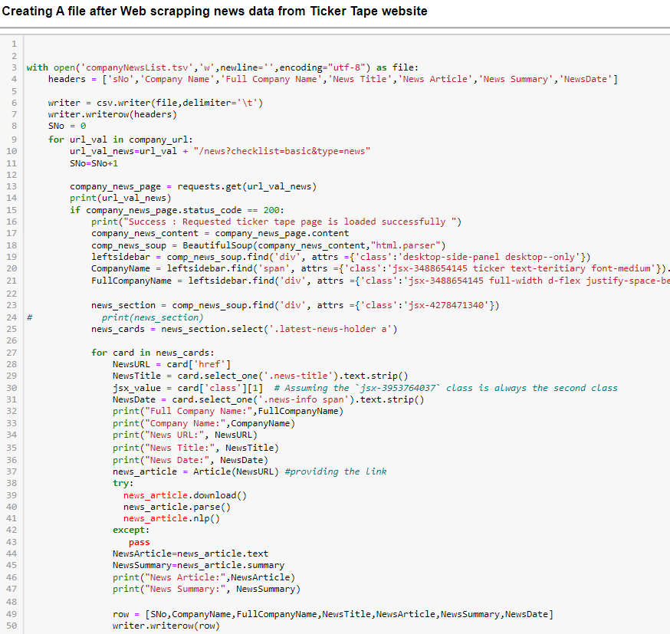
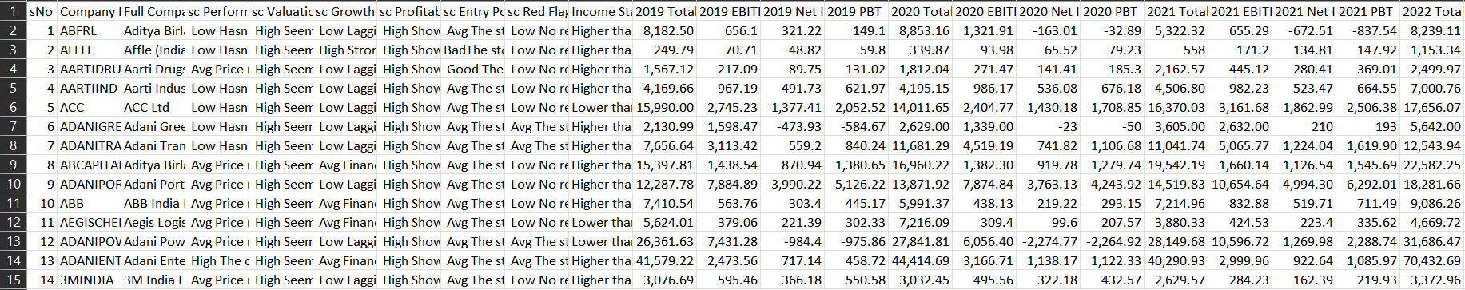
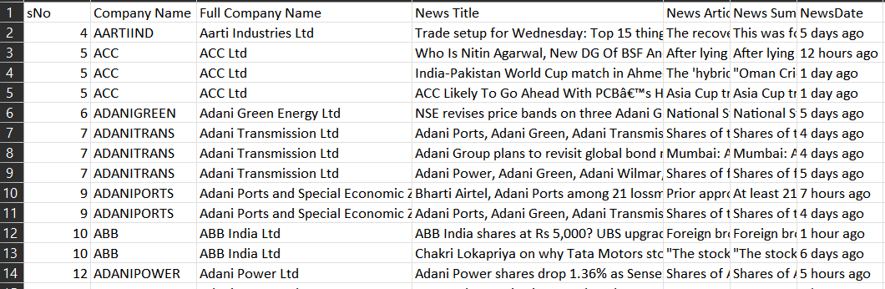
Modelling Web-scrapping –> Jupyter Notebook
Input:
Output:

Slide 14
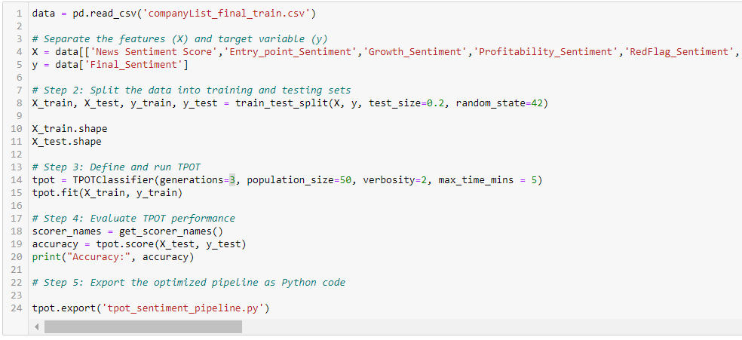
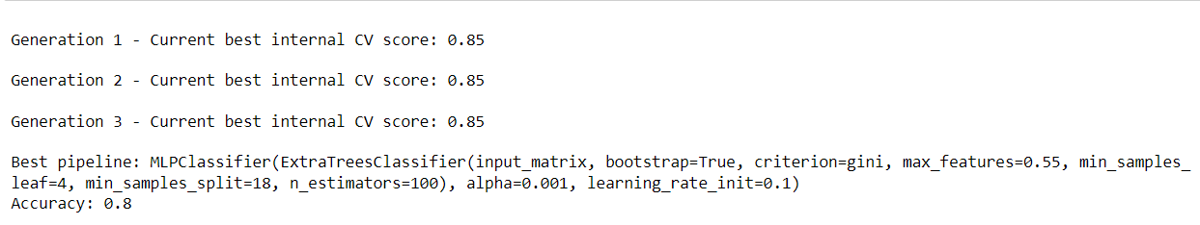
Modelling Model Preparation –> Auto ML using Jupyter Notebook
Input:
Output:

Slide 15
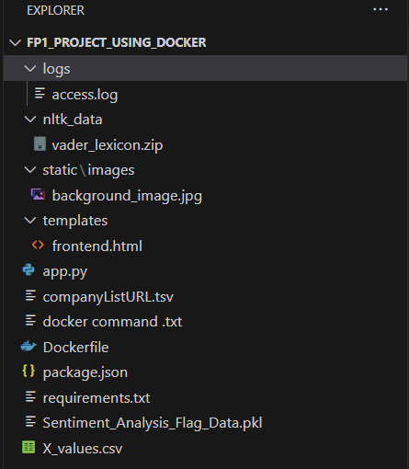
Modelling Back-end –> Flask API Framework using Python
Folder Structure of the Machine Learning Model

Slide 16
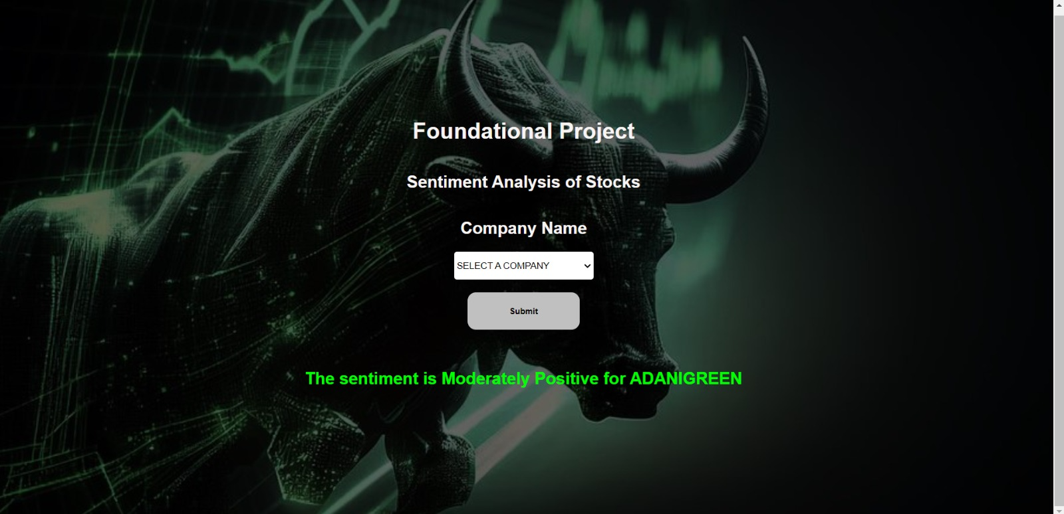
Modelling Front-end –> DHTML
User Interface

Slide 17
Evaluation Planned
DATA EVALUATION
EVALUATION TECHNIQUES WILL BE USED
Balanced Approach for the Dataset will be taken for Evaluation
Splitting Mode: Regular Express
And Split will be:
Training of Model: 60%
Validation: 20%
Testing: 20%
Confusion Matrix
ROC Curve
Cross-validation
A/B Testing
Notes:
Evaluation-> Splitting should be done Randomly to avoid Bias of any Kind
Large test set => estimate future error as
accurately as possible (vs)
Large training set => better estimates
How large should a training set be?
Evaluation Techniques->
Confusion Matrix: A confusion matrix can be used to evaluate the performance of the model by comparing the predicted sentiment with the actual sentiment. It provides a detailed summary of the model's performance, including metrics like accuracy, precision, recall, and F1 score.
ROC Curve: An ROC (Receiver Operating Characteristic) curve can be used to evaluate the model's performance by plotting the true positive rate against the false positive rate. It provides a visual representation of the trade-off between sensitivity and specificity.
Cross-validation: Cross-validation can be used to evaluate the model's performance by testing the model on a subset of the data and using the remaining data to train the model. This helps to assess the model's ability to generalize to new data.
A/B Testing: A/B testing can be used to evaluate the model's performance by comparing the performance of the model to a baseline model or a previous version of the model. This helps to assess the improvement in performance of the model.

Slide 18
Evaluation Done
DATA EVALUATION
EVALUATION TECHNIQUES USED
Balanced Approach for the Dataset has been taken for Evaluation
Splitting Mode: Regular Express
And Split will be:
Training of Model: 100 Stocks
Validation and Testing: 400 Stocks Step 1: 50 Step 2: 100 Step 3: 100 Step 4: 150
Confusion Matrix
f-Score
Precision
Recall
Cross-validation (Done Manually)
Notes:
Evaluation-> Splitting should be done Randomly to avoid Bias of any Kind
Large test set => estimate future error as
accurately as possible (vs)
Large training set => better estimates
How large should a training set be?
Evaluation Techniques->
Confusion Matrix: A confusion matrix can be used to evaluate the performance of the model by comparing the predicted sentiment with the actual sentiment. It provides a detailed summary of the model's performance, including metrics like accuracy, precision, recall, and F1 score.
ROC Curve: An ROC (Receiver Operating Characteristic) curve can be used to evaluate the model's performance by plotting the true positive rate against the false positive rate. It provides a visual representation of the trade-off between sensitivity and specificity.
Cross-validation: Cross-validation can be used to evaluate the model's performance by testing the model on a subset of the data and using the remaining data to train the model. This helps to assess the model's ability to generalize to new data.
A/B Testing: A/B testing can be used to evaluate the model's performance by comparing the performance of the model to a baseline model or a previous version of the model. This helps to assess the improvement in performance of the model.

Slide 19
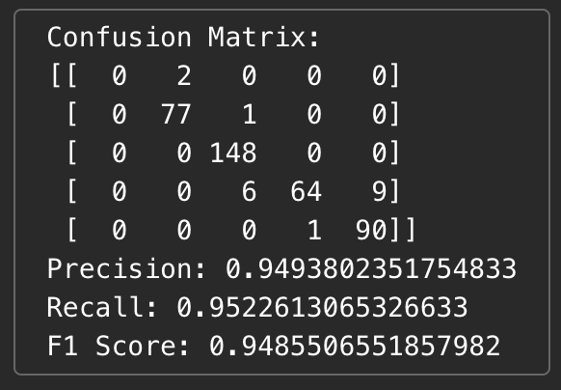
Evaluation Techniques
Confusion Matrix
This summarizes the performance of a classification model, where each row in the matrix corresponds to an actual class, and each column corresponds to a predicted class.

Slide 20
Evaluation Techniques
Precision
This performance metric that measures the accuracy of positive predictions. the precision is 94.9%, indicating that the model has a high percentage of correctly predicted positive instances.

Slide 21
Evaluation Techniques
Recall
This measures the ability of a model to identify all positive instances. The recall value in this case is 95.2%, indicating that the model has a high capability to correctly identify positive instances.

Slide 22
Evaluation Techniques
f1 – Score
This is the harmonic mean of precision and recall. The F1 score in this case is 94.85%, which combines precision and recall into a single value.

Slide 23
Evaluation Techniques
Cross Validation (Manually Done)
Company Name | Closing Day – 13 June | Opening Day - 14 June | Percentage Change | Predicted by the ML Model | Actual Market Share | Result
CESC | 72.05 | 71.75 | - 0.416% | Negative | Negative | PASS
Just Dial | 767.75 | 762.0 | - 0.71% | Negative | Negative | PASS
BSOFT | 335.90 | 335.25 | - 0.19% | Fairly Negative | Fairly Negative | PASS
BIRLACORPN | 1197.40 | 1189.20 | - 0.68% | Fairly Negative | Negative | FAIL
ADANIENT | 2462.55 | 2469.90 | 0.29% | Fairly Positive | Fairly Positive | PASS
DMART | 3677.90 | 3739.90 | 1.6% | Positive | Positive | PASS
AARTIDRUGS | 461.25 | 462.90 | 0.35% | Neutral | Positive | FAIL
Negative Infinity– -0.31% - Negative
-0.3 – -0.05 – Fairly Negative
-0.04 – 0.04– Neutral
0.05– 0.3– Fairly Positive
0.31- Positive Infinity - Positive

Slide 24
Model Deployment Planned
Webservice Deployment: AZURE MACHINE LEARNING STUDIO (AMLS)
Generate API Key using the AMLS
API Key to be used while building the Final Application for End-user Interaction

Slide 25
Model Deployment Processed
Webservice Deployment: DOCKER
We are using webservice provider which is available for 4 Hours for FREE Internationally.

Slide 26
Monitoring and Maintenance
MONITOR
MAINTENANCE
Results to be checked to enhance the quality of the ML Model by re-training the Model with newer and updated versions along with more words in the word bank for better Sentimental Analysis, also to retrain the model if the accuracy drops to 65%.
Reiterate the developed Model to create better results, to enhance accuracy and understand the sentiment of the public using the developed Machine Learning Model

Slide 27
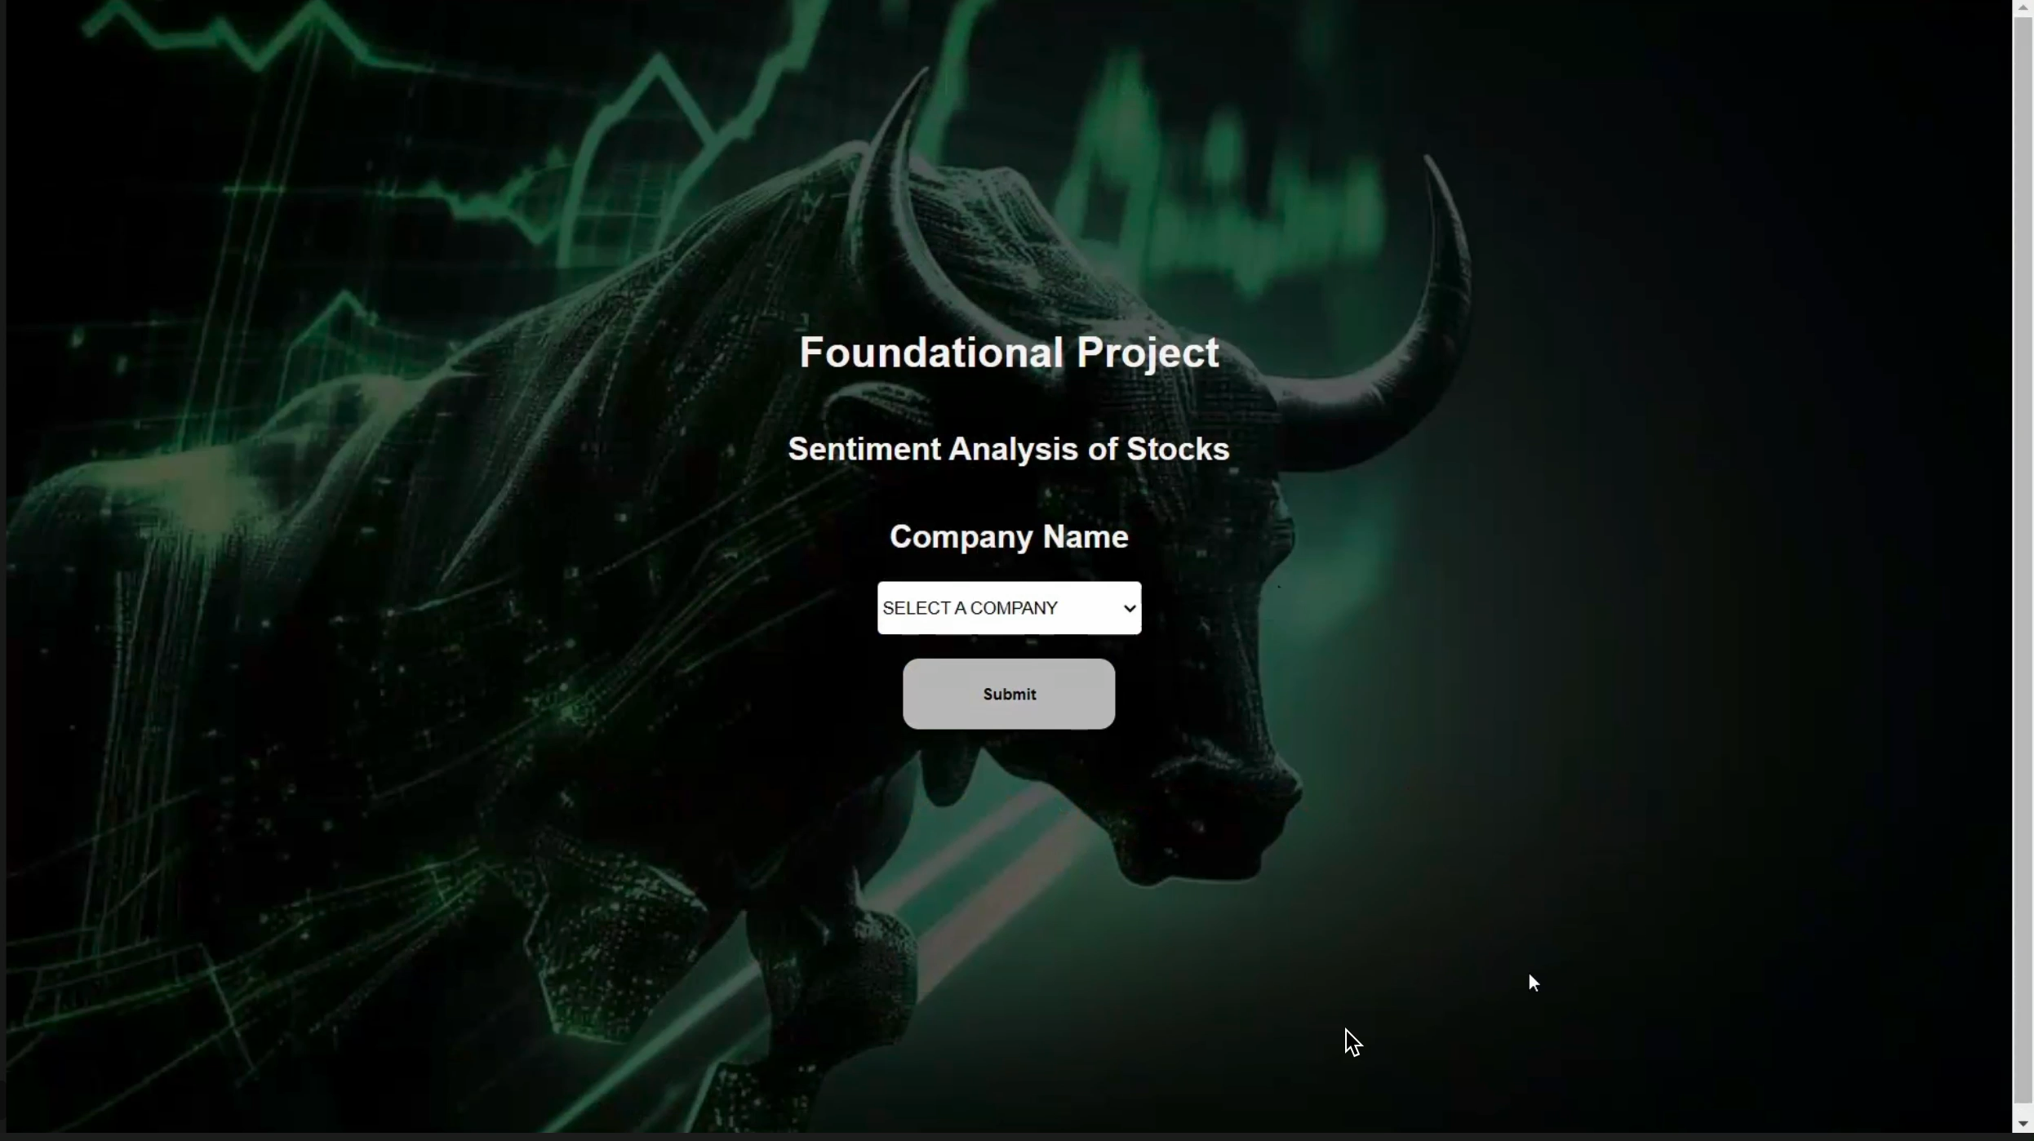
Working of the Model Moderately Negative

Slide 28
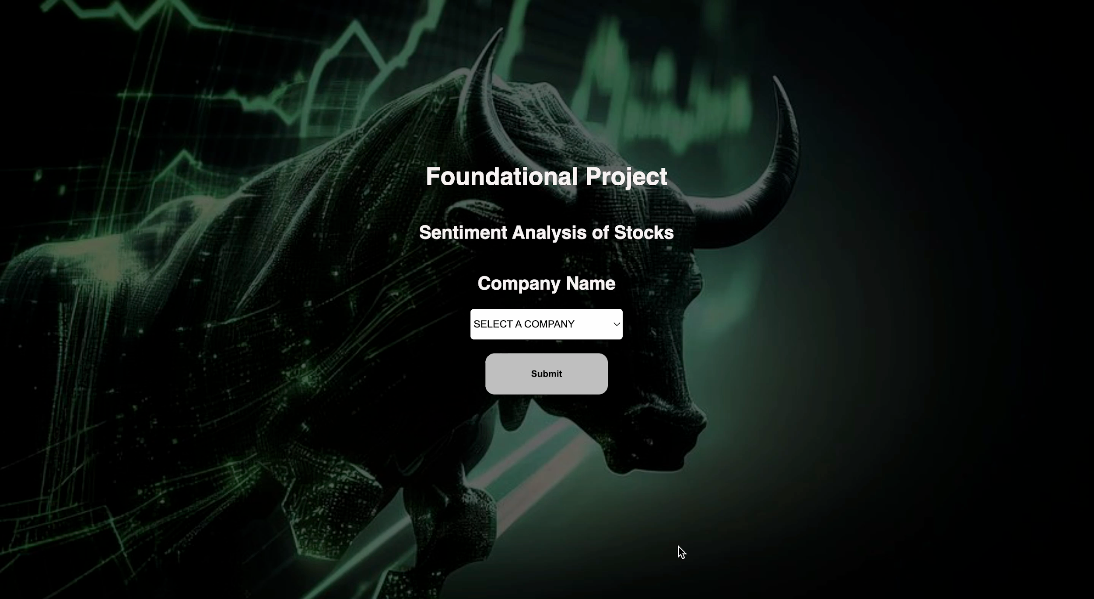
Working of the Model Neutral

Slide 29
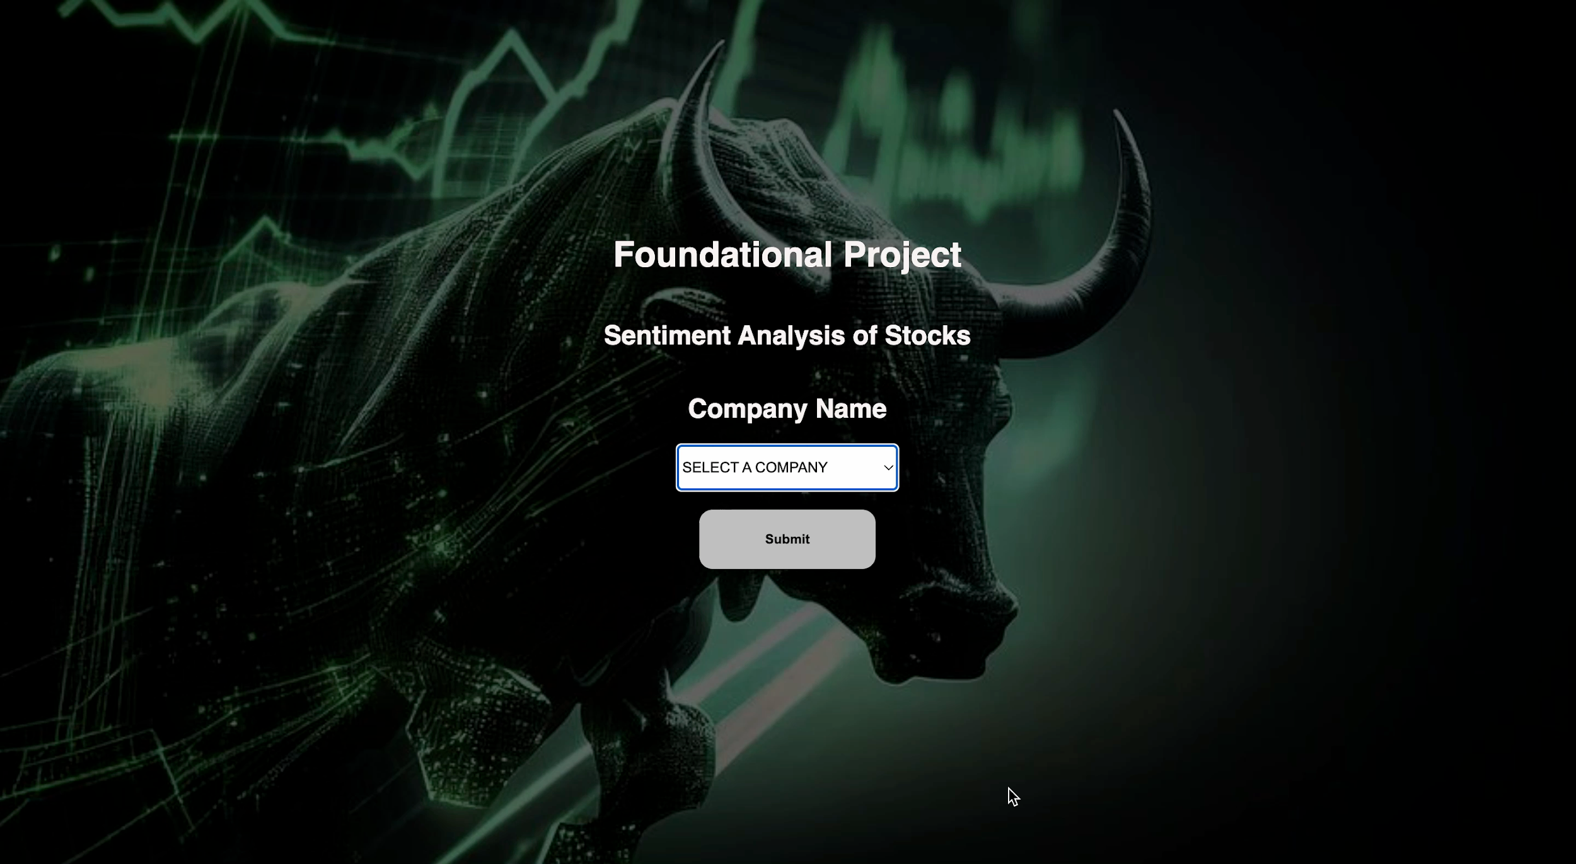
Working of the Model Moderately Positive

Slide 30
Challenges and Limitations
CHALLENGES
LIMITATIONS
Scrapping challenges
Scrapping from Google News failed as Google allows only 200 hits in a day.
For few details which required for us to predict sentiment, they were taking time to load, so instead we referred to the Static Data at the Market Opening.
Bin Size for Sentiments was increased from 3 to 5 to show Variations from the Model, i.e., Negative, Fairly-Negative, Neutral, Fairly-Positive, Positive
The result is predicted using Performance Metrics and Financial Information, if there hasn't been any news regarding that stock price in recent time.
Data was incomplete/ inconsistent for companies which opened/closed during or after the time frame of 4 years, i.e., 2019-Present
Based on the functionality of Lexicon Library, certain stock price results are varied, sentiments captured based on polarity of the news articles and not the actual stock market price.
NOTE:
We went from No Code-to-Code Approach as we were facing some difficulties in clubbing various methodologies and their respective tasks, which were necessary for Model Completion.
30% is the Historic Data and 70% is Sentiments from the News Data collected.

Slide 31
Future Scope
To diversify news sources and implement effective scraping strategies: Explore alternative news sources and develop a scraping mechanism that adheres to limitations, such as Google's maximum hits per day restriction. This ensures a larger volume of news articles for analysis.
To enhance sentiment analysis model and granularity: Invest in improving the sentiment analysis model to provide more detailed sentiment scores. This could involve training the model on a larger dataset with fine-grained sentiment labels, enabling better understanding of sentiment variations.
Expand data sources and update frequency: Broaden the range of data sources beyond news articles, such as social media feeds or official company announcements. Increase the frequency of data updates to capture the most recent information available.
Develop new mechanisms for new companies and data validation: Create automated processes to detect and track newly listed companies, ensuring comprehensive data from their inception. Implement a manual data verification process to address incomplete or inconsistent data for companies that opened or closed during or after the selected time frame.
Incorporate market data analysis and hybrid modeling: Include market data analysis alongside sentiment analysis to capture the impact of actual stock market price movements on sentiment results. Develop a hybrid model that combines sentiment analysis with market indicators to provide more accurate and comprehensive stock price predictions.

Slide 32
References
https://www.sciencedirect.com/science/article/abs/pii/S0957417415005126
https://www.sciencedirect.com/science/article/abs/pii/S0950705114001440
https://peerj.com/articles/cs-476/
https://www.kaggle.com/code/shritech1404/bag-of-word-for-stock-market-sentiment-dataset
https://www.kaggle.com/code/rohit0906/stock-sentiment-analysis-using-news-headlines
https://www.kaggle.com/code/satyaprakash13820/stock-sentiment-analysis
https://www.sciencedirect.com/science/article/abs/pii/S0950705114001440
https://www.analyticsvidhya.com/blog/2021/06/vader-for-sentiment-analysis/
https://www.geeksforgeeks.org/newspaper-article-scraping-curation-python/
https://blog.finxter.com/newspaper3k-a-python-library-for-fast-web-scraping/
https://github.com/cjhutto/vaderSentiment
https://towardsdatascience.com/sentimental-analysis-using-vader-a3415fef7664
https://www.nltk.org/_modules/nltk/sentiment/vader.html

Slide 33
Thank you!!!

